Slide 1
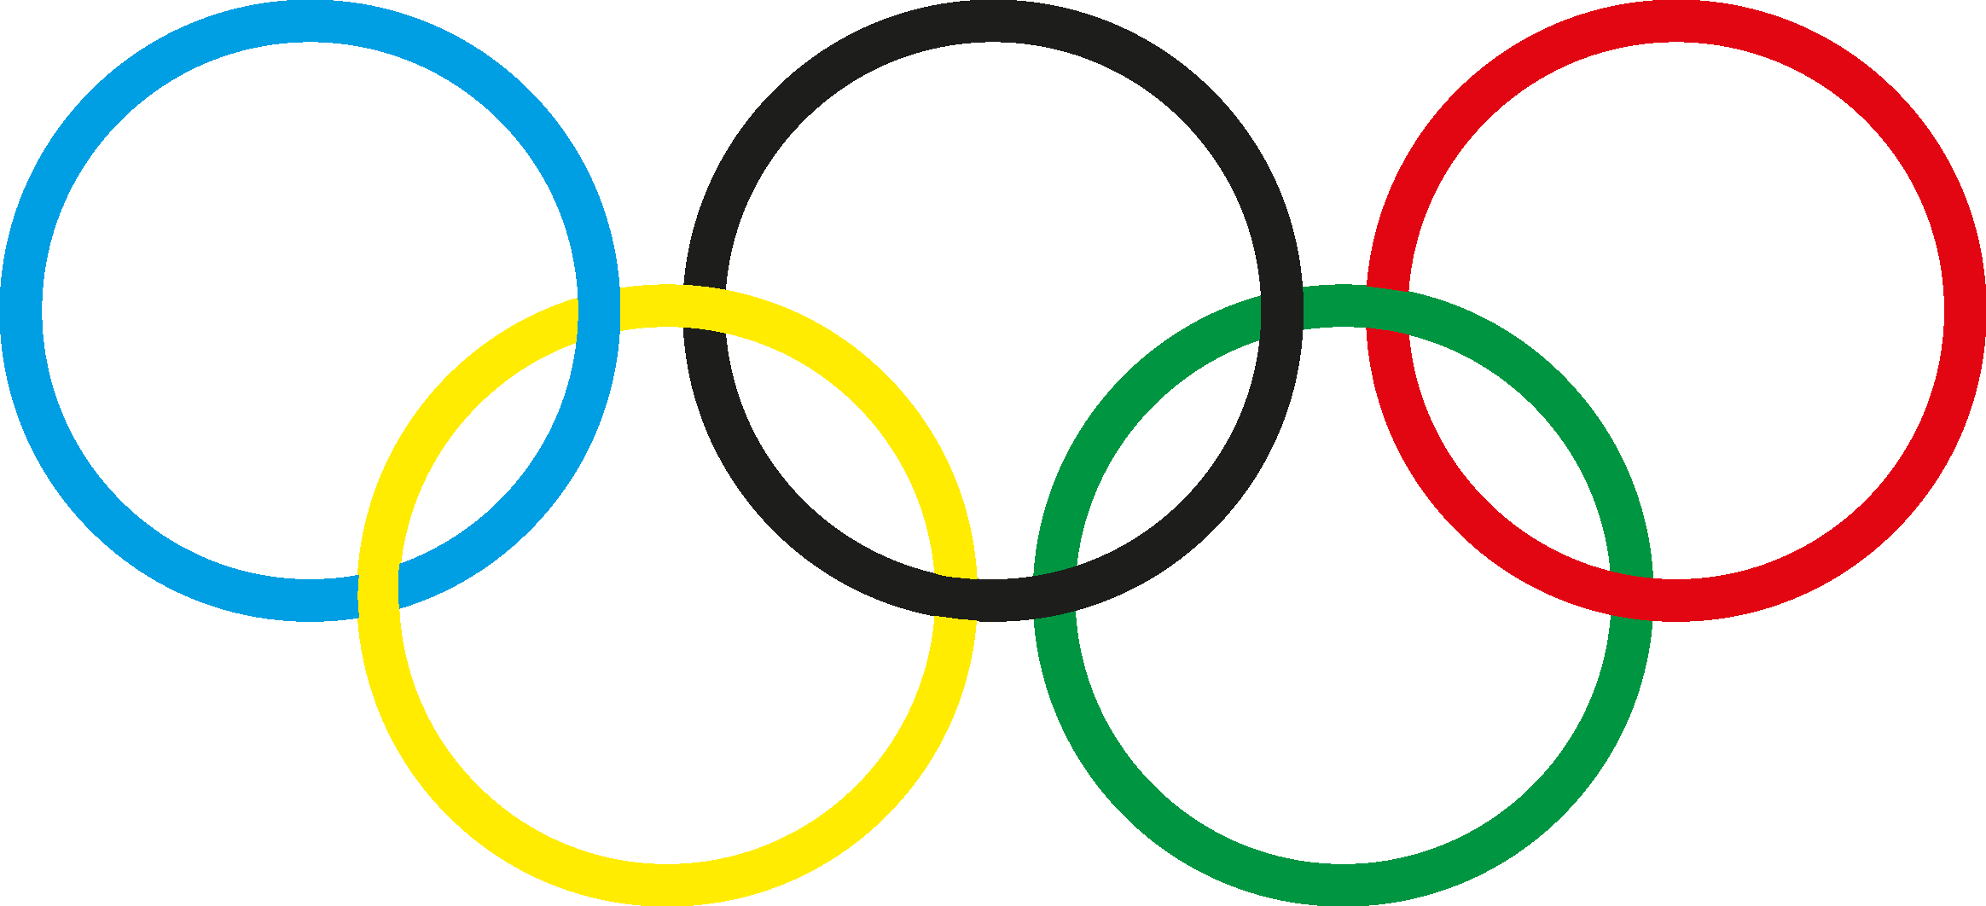
Analysis of Summer Olympic Medal Winning Trends
(1896-2014)
Jesse Edwards

Slide 2
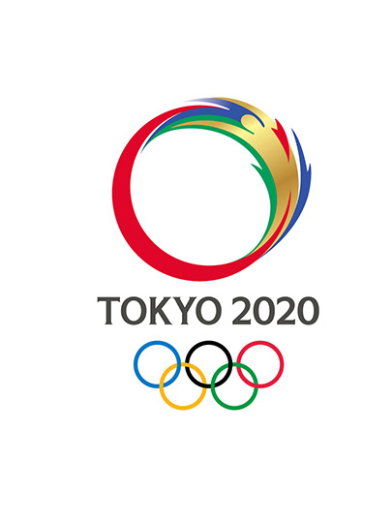
Overview
The motivation for analysing Olympic Medal winning trends came from the most recent Tokyo Olympics medal table
Japan had achieved a total medal tally of 58, which seemed incredibly high for a nation that would not typically be considered an Olympic super power
We were interested in exploring the factors that could contribute towards a nation’s ability to win medals at the Summer Olympics
Our data was acquired from Kaggle and contained a record of every Olympic Medal winner from the first games in 1896 until 2014
The question: “are there any identifiable trends in the medal winners of the new sports added over time, and has this any impact on a nations overall medal winning dominance?”

Slide 3
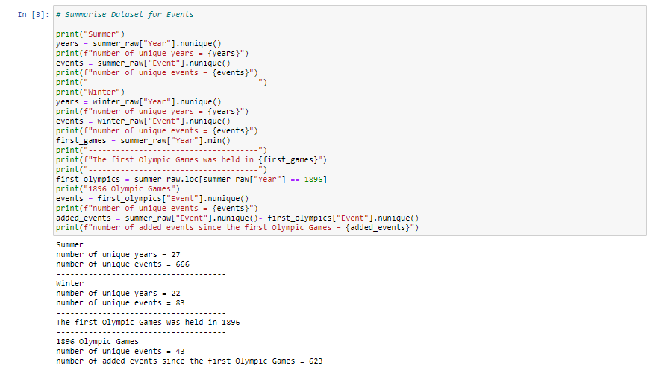
Data Exploration
The first task was to explore the data to see the number of events that have been added over the years
We initially intended to analyse both the Summer and Winter Olympic games, but after initial exploration it was clear that the Summer games was going to be the most interesting and meaningful dataset

Slide 4
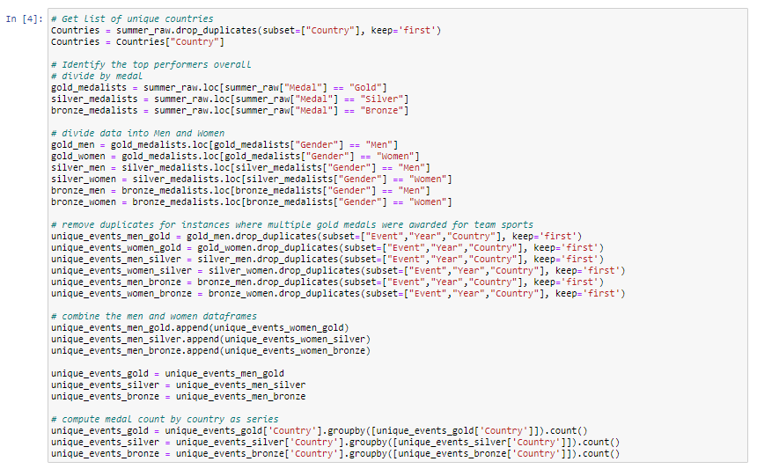
Data Exploration – Medal Counts for All Events
First we needed to break the data down so that we can form a new DataFrame of medal counts for all events
We need to aggregate a count of medals for each country
Two problems were encountered with the dataset - every medal winner is listed by name, which includes multiple medal winners for team events (such as football) and we also have both men and women combined in the data and all medal classes
We needed to divide the data by each medal class and by each sex before we could reduce the team events down to a count of one medal per event
This was done by dropping duplicate values for the “Event”, “Year”, and “Country” columns, whilst keeping the first value and then appending our separate sex DataFrames back together.
We then count the number of medals and group by country for each of our three series (gold, silver, bronze)

Slide 5
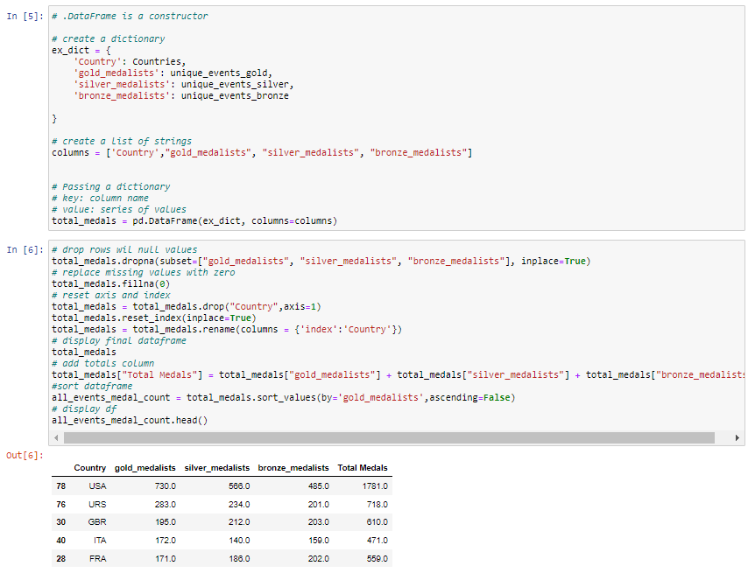
Data Exploration – Medal Counts for All Events
Next we needed to add the series to a dictionary and combine with a list of strings as column headers to create our DataFrame for analysis
Drop any rows with null values in all medal classes
Some countries only feature in some of the medal class columns, so we need to fill null values with zero
Reset axis and index
Add a totals column to display the combined total of medals for each country
Sort rows by Country in descending order
We now have our final DataFrame – each column will be used as a separate series for our analysis

Slide 6
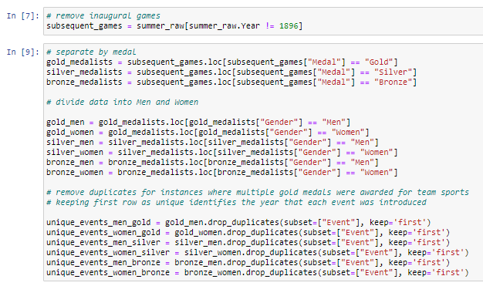
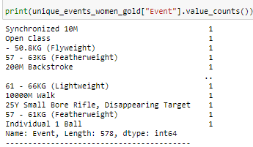
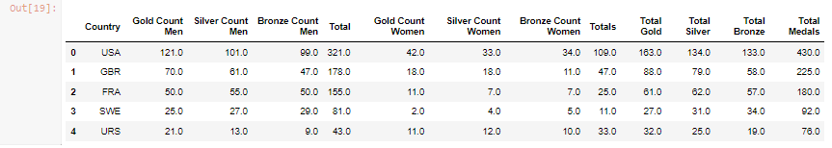
Data Exploration – Medal Counts for only New Events
Next we needed to break the data down into another DataFrame that we will use for our analysis of medal counts for the new events in the year that they were added
First job was to move all events that were featured in the initial Summer Games of 1896
Split between men and women and then each medal class before then removing the duplicate rows for team events
Check all series to ensure that we have correctly reduced each series down to one medal of each class for each sex in each event
Create DataFrame as before using the medal class series for each sex and also create total columns to combine medal count for men and women by medal class and another column that totals all medals
We now have everything that we need for our analysis in two separate DataFrames

Slide 7
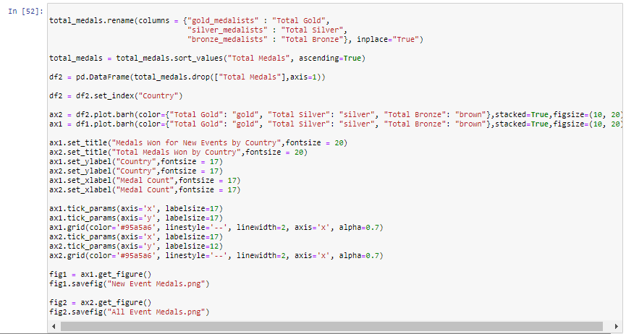
Data Analysis
Created two different figures using Pandas Plot
“Medals Won for New Events by Country”
This shows us the total number of medals won by each country in new events in the year they were added to the Olympic Games – we broke the count into different medal classes
“Total Medals Won by Country
This shows us the total number of medals won by each country across all events in all Olympic Games – we broke the count into different medal classes

Slide 8
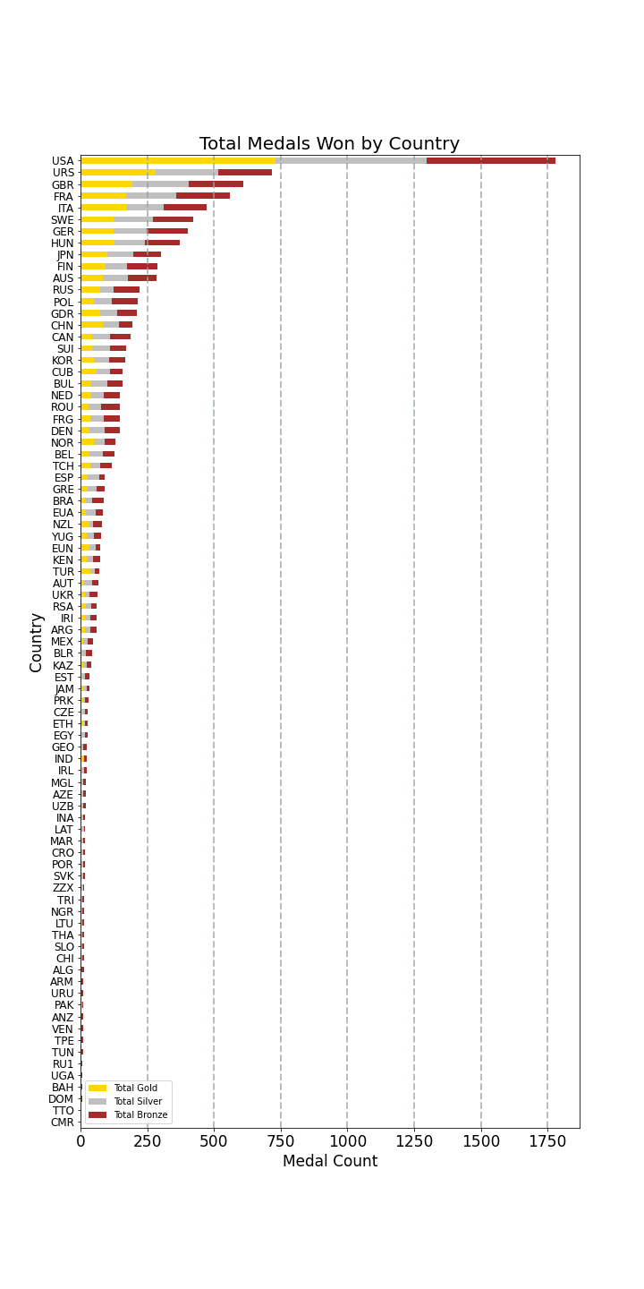
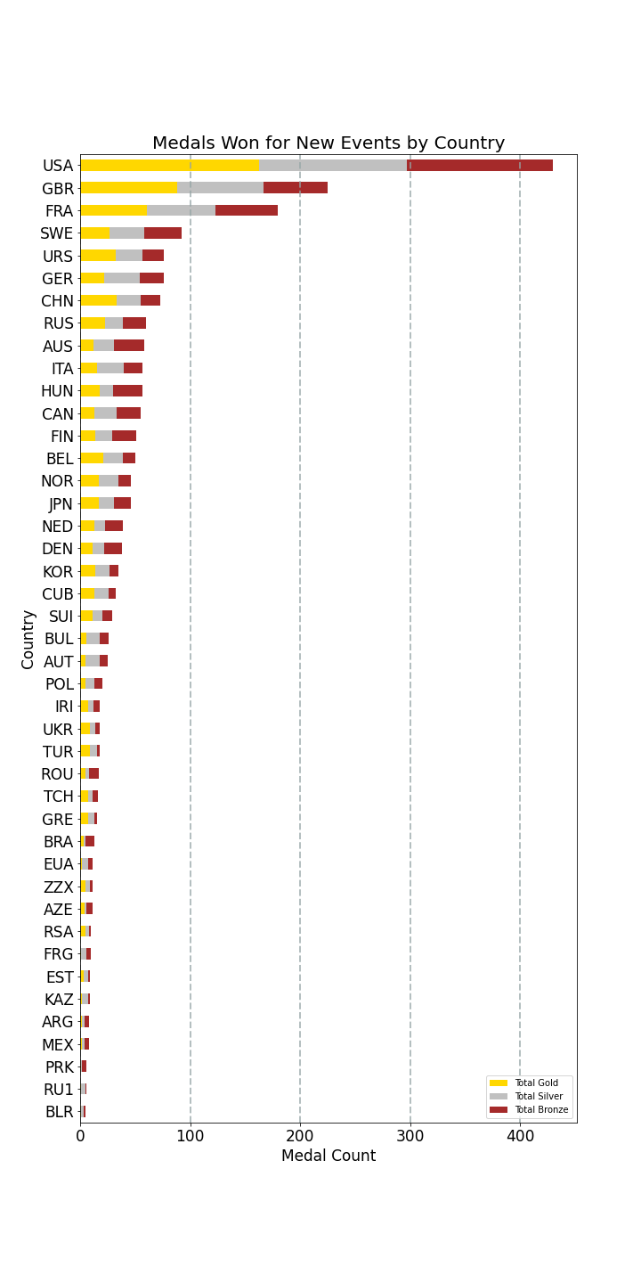
Data Analysis
We can see that USA are most dominant in both plots
21% of medals for new events were won by USA (430/2095)
25% of USA total medals for all events were won in new events in the year they were added (430/1781)

Slide 9
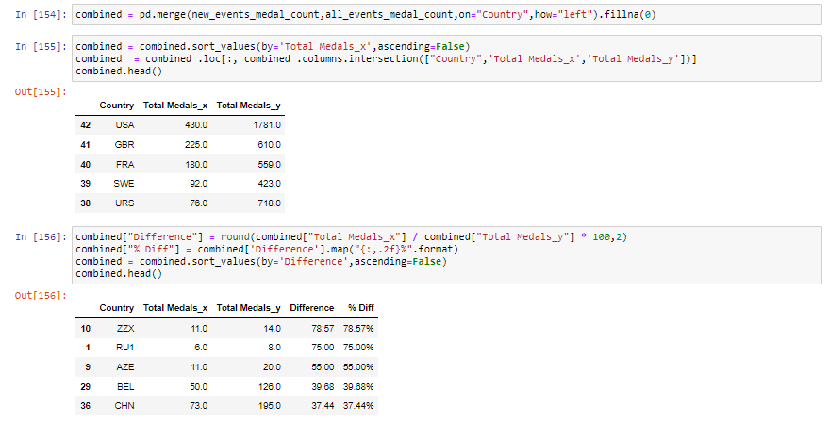
Data Analysis
We then wanted to see which nations had the highest percentage of medals made won in new events
Merged both of our DataFrames and locked to just the Country and both Totals columns
Created two new columns for the difference and % Difference
Created a new figure using pandas plot

Slide 10
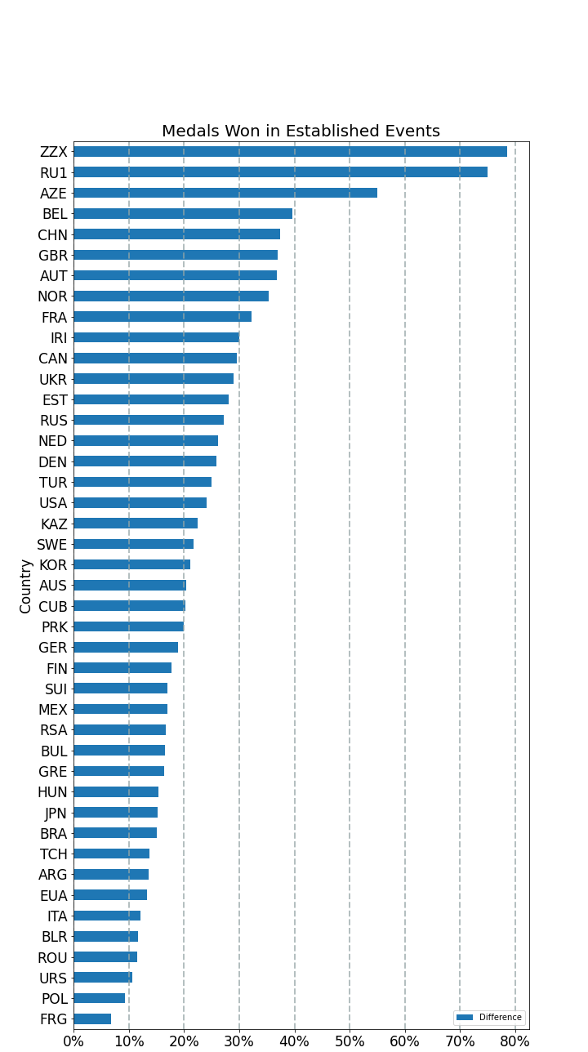
Data Analysis
ZZX is actually an old IOC code used for teams consisting of different nationalities, which happened in some of the earlier games
RUI is also a defunct code used for the Russian Empire
Azerbaijan is the nation with the highest proportion of their total medals made up from new events 55% (11/20)
Belgium also have a high proportion of total medals won in new events at 40% (50/126)
China was surprising in that 37% of total medals have been won in new events (73/195)
Great Britain have also won 37% of their medals in new events and they have the third highest overall count at 610 total medals

Slide 11
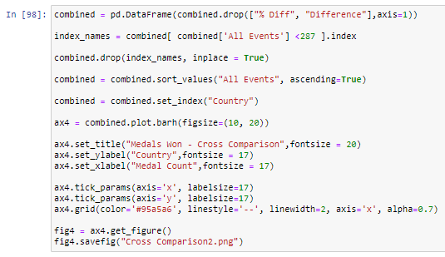
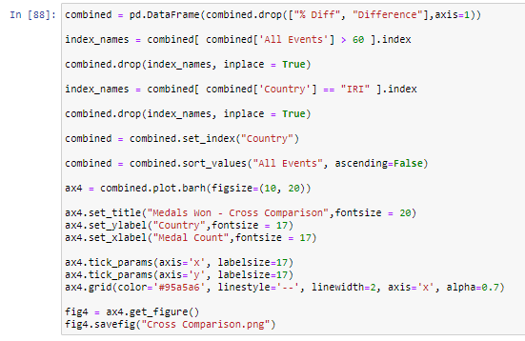
Data Analysis
I wanted to see the relationship between medals won for the top and bottom half of our dataset
We dropped rows based on a condition to return the top and bottom 10 nations for total medal count
We then plotted both series on two separate plots (top & bottom) so that we could look more closely at the relationship between medals won in all events and medals won in new events

Slide 12
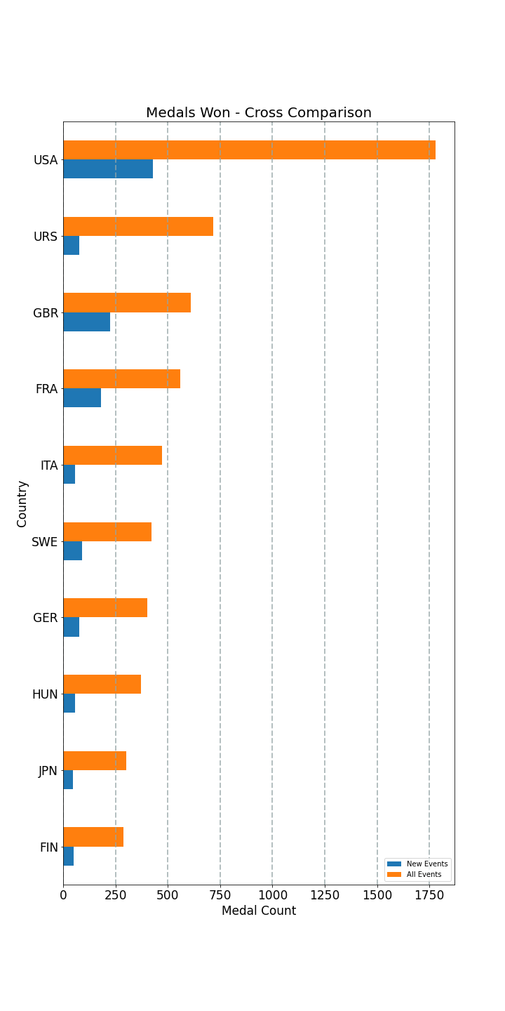
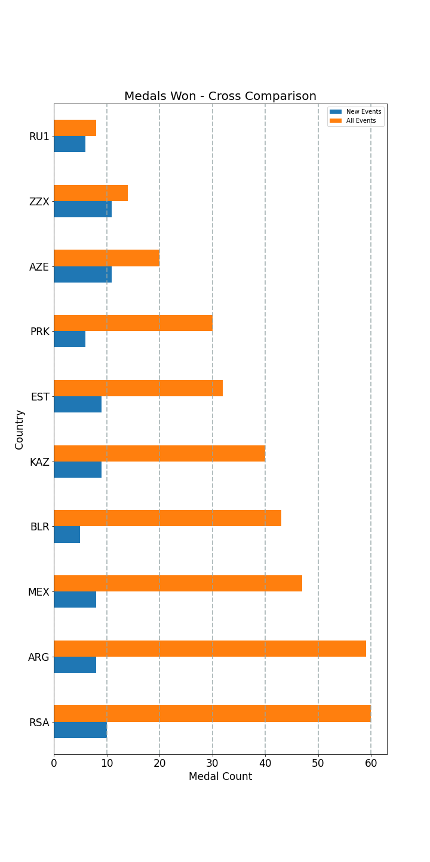
Top Ten Overall Medal Winners
Bottom Ten Overall Medal Winners
Conclusion
This analysis shows that the practice of adding new events to the Olympic Games each time gives some of the lower medalling nations more opportunity to win medals in the future, however, we can also see that the vast majority of new events are won by the highest overall performing nations, such as USA, Russia and GBR
Great Britain indicates a trend of intentionally targeting and training for new events in order to increase the total medal count, with almost half of all medals one coming from new events in the year that they were added
There are many contributing factors to consider, such as national wealth, funding, and population, but our analysis indicates that the best performing nations continue to benefit from the addition of new Olympic events
Limitations
A decision must be made whether to combine IOC codes – for example – Russia has multiple codes to cover the Soviet Union etc. I decided to keep the separate for this analysis, but there is an equal argument for combining the medal counts

